Slide 1
TABLES AND KEYS
BY:PARUL MADAN(AP)
CSE(GEU)
For reference:
https://youtu.be/V04ucjoKqgg by Parul Madan

Slide 2
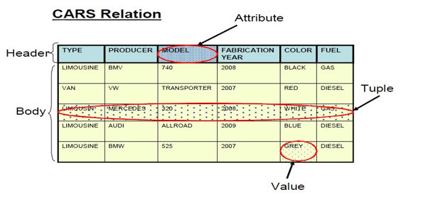
RELATION
REALTION: is nothing but it is a table consist of rows and columns
For reference:
https://youtu.be/V04ucjoKqgg by Parul Madan

Slide 3
Relation consist of heading and body
Heading consist of fixed set of attributes A1,A2,A3….An such that each attribute Ai corresponds to exactly one of the underlying domain D1,D2,D3…..Dn
A body consist of time varying type of tuples , where each tuples consist of a set of attribute –value pair (Ai-Vi).
Degree of relation: No of attributes in a relation.
Cardinality of relation: No of instances or tuples.
Tuples: representation of rows
Domain: representation of attributes
For reference:
https://youtu.be/V04ucjoKqgg by Parul Madan

Slide 4
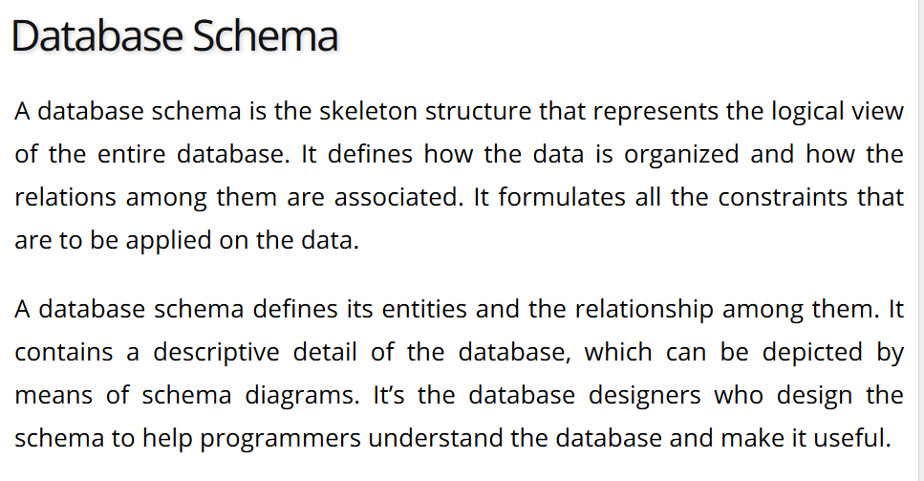
For reference:
https://youtu.be/V04ucjoKqgg by Parul Madan

Slide 5
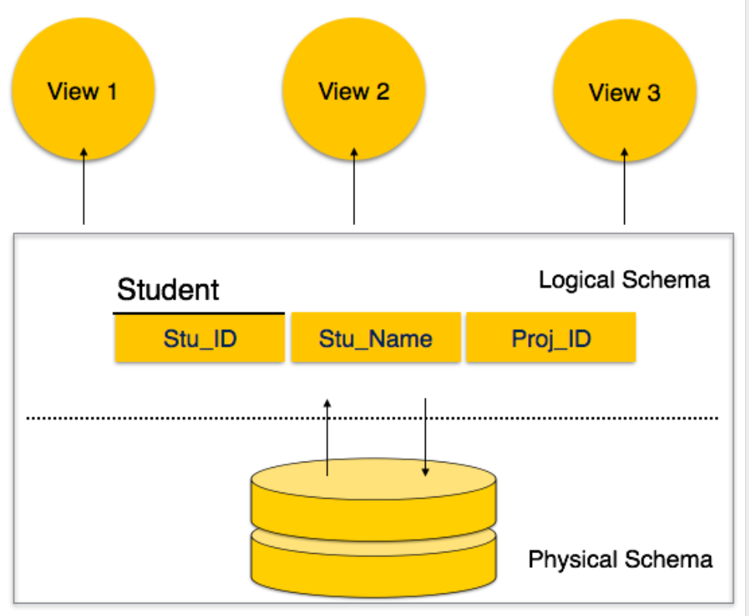
For reference:
https://youtu.be/V04ucjoKqgg by Parul Madan

Slide 6
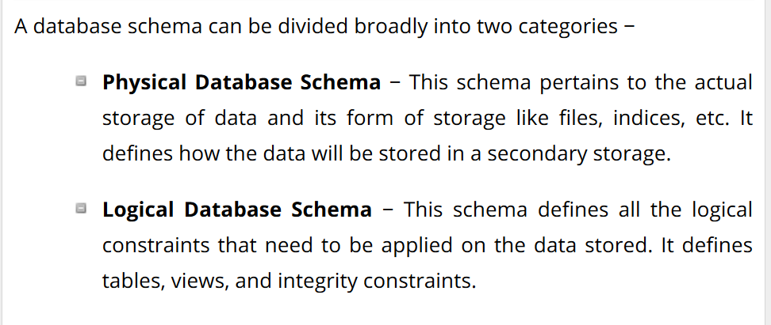
For reference:
https://youtu.be/V04ucjoKqgg by Parul Madan

Slide 7
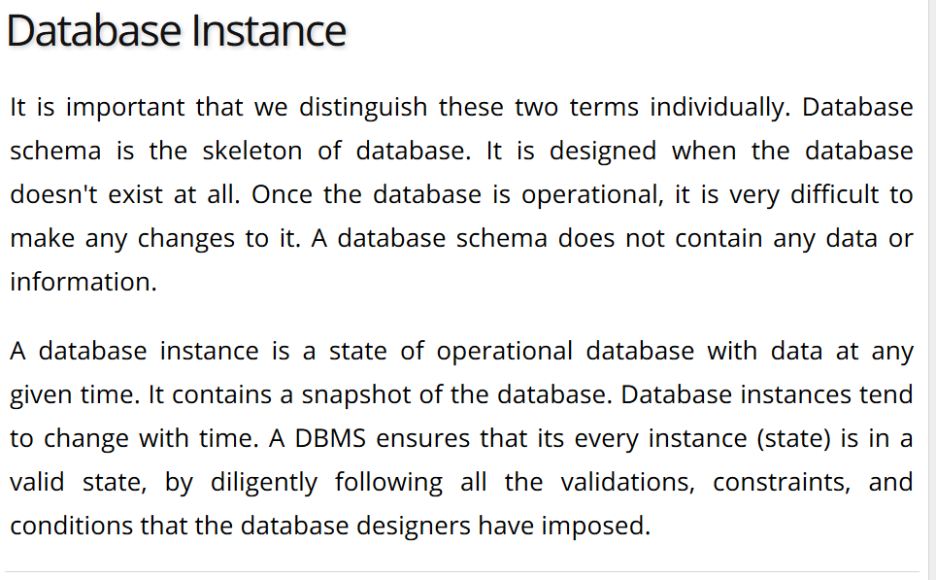
For reference:
https://youtu.be/V04ucjoKqgg by Parul Madan

Slide 8
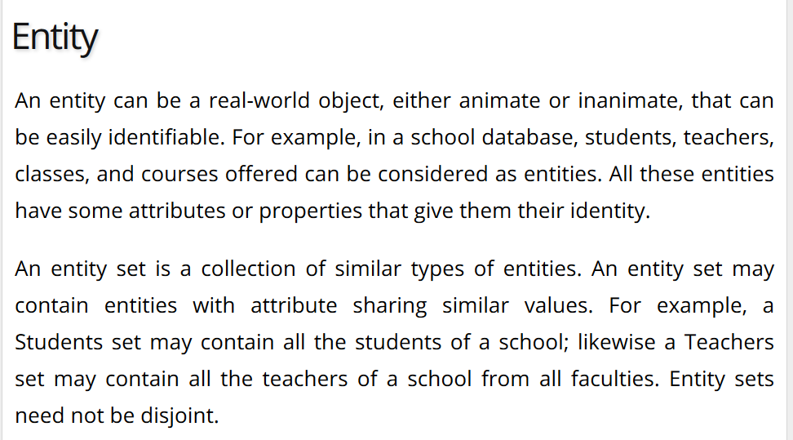
For reference:
https://youtu.be/V04ucjoKqgg by Parul Madan

Slide 9
ENTITY CONT..
ENTITY IS A PERSON , PLACE , THING OR EVENT FOR WHICH DATA IS COLLECTED AND MAINTAINED
FOR EX-
PERSON: teacher, player , doctor
PLACE: country , city
OBJECT: vehicle , toy, furniture
EVENT: purchase , admission , registration
CONCEPT: account, programming
AN ENTITY IS REPRESENTED BY RECTANGLE
For reference:
https://youtu.be/V04ucjoKqgg by Parul Madan

Slide 10
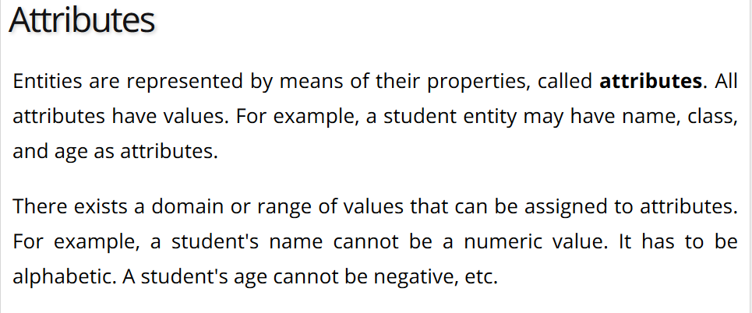
For reference:
https://youtu.be/V04ucjoKqgg by Parul Madan

Slide 11
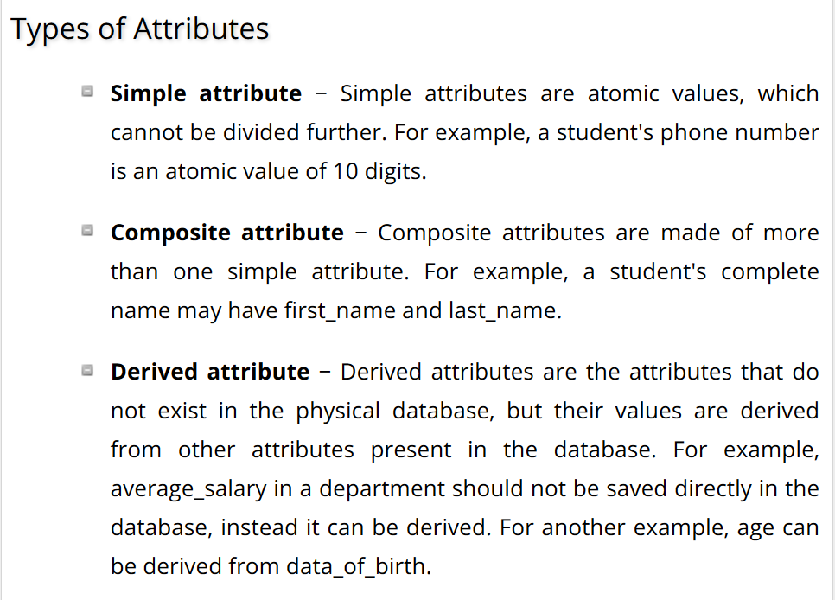
For reference:
https://youtu.be/V04ucjoKqgg by Parul Madan

Slide 12
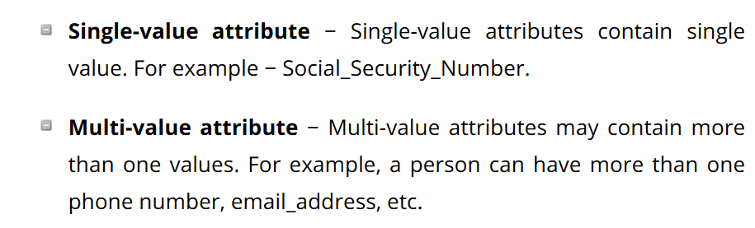
For reference:
https://youtu.be/V04ucjoKqgg by Parul Madan

Slide 13
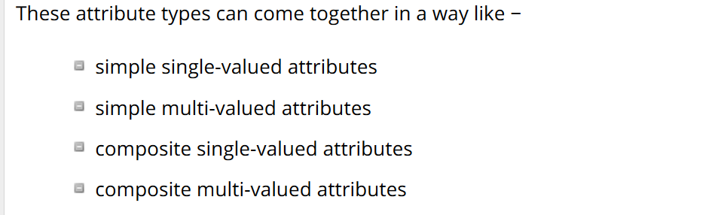
For reference:
https://youtu.be/V04ucjoKqgg by Parul Madan

Slide 14
KEYS
Keys: It is the minimum number/set of attributes/columns that uniquely identify a row/tuple
Customer_id | Cust_name | Cust_address | Cust_pin
1 | ERA | 202 CIVIL LINES | 247667
2 | JASON | 204 CIVIL LINES | 247667
3 | AMMA | 505 DEHRADUN | 248002
4 | ERA | 204 CIVIL LINES | 247667
For reference:
https://youtu.be/V04ucjoKqgg by Parul Madan

Slide 15
Consider CUSTOMER table ,customer_id can uniquely identify a row. Therefore cust_id can be a key of the relation.
If we consider(customer_id, cust_name) it can identify a row uniquely ,but it is not a key because it is not a minimal set of attributes. So key must be minimal set of attributes to uniquely identify a row.
If we consider(cust_name,cust_address)it can identify a row uniquely and it can be a key because nether cust_name nor cust_address can individually identify row uniquely .
For reference:
https://youtu.be/V04ucjoKqgg by Parul Madan

Slide 16
TYPES OF KEYS
SIMPLE KEY: key with only one attribute/column ex-CUST_ID is the simple key for the above relation.
COMPOSITE KEY : key with two or more attributes ex(CUST_NAME,CUST_ADDRESS)
SUPER KEY: set of all the attributes that uniquely identify each row.
Ex-{CUST_ID},{CUST_ID,CUST_NAME},{CUST_NAME,CUST_ADDRESS},{CUST_ADDRESS},{CUST_NAME,CUST_PIN},{CUST_ID,CUST_ADDRESS},{CUST_ID,CUST_PIN}{CUST_ID,CUST_NAME,CUST_ADDRESS},{CUST_ID,CUST_NAME,CUST_ADDRESS,CUST_PIN}
For reference:
https://youtu.be/V04ucjoKqgg by Parul Madan

Slide 17
KEYS CONT…
CANDIDATE KEY: minimal set of SUPERKEYS which cant not be further divided , and can uniquely identify each row
Ex- {CUST_ID}, },{CUST_NAME,CUST_ADDRESS}
PRIMARY KEY: one of the CANDIDATE KEY that the DB-DESIGNER chooses to maintain uniqueness is called PRIMARY KEY.
THERE ARE SOME RULES WHEN YOU CHOOSE A PRIMARY KEY:
VALUES SHOULD BE UNIQUE FOR EACH AND EVERY TUPLE
VALUES CAN NOT BE NULL
THERE SHOULD BE ATMOST ONE PRIMARY KEY PER TABLE.
For ex- create table employees(emp_id number(4) PRIMARY KEY)
For reference:
https://youtu.be/V04ucjoKqgg by Parul Madan

Slide 18
KEYS CONT…
ALTERNATIVE KEYS: only one candidate key is chosen to form a PRIMARY KEY, rest CANDIDATE KEYS are called as ALTERNATIVE KEY.
FORIEGN KEYS: it is an attribute or group of attributes in a relational database that provides that provide a link between data in two tables. For ex-
PRIMARY KEY
Emp_id | Emp_name | address | Dep_id
E101 | REENA | DDN | D101
E102 | RAJAT | DDN | D102
E103 | SHIV | DELHI | D101
E104 | RAM | DELHI | D104
Dep_id | Dep_name | Hod | Location_id
D101 | CS | DR.DEVESH | L101
D102 | IT | DR. DEVESH | L101
D103 | EC | DR.IRFAN | L102
FOREIGN KEY
PRIMARY KEY
For reference:
https://youtu.be/V04ucjoKqgg by Parul Madan

Slide 19
KEYS CONT..
CONSTRAINT ON FOREIGN KEY :
VALUES OF FOREIGN KEY IN CHILD TABLE CAN BE DUPLICATE OR NULL BUT IT IS MENDATORY TO HAVE VALUES WHICH LIES IN PARENT TABLE.
FOR EX- create table employee(constraint dep_id_fk foreign key (dep_id) references department(dep_id))
SELF REFERENTIAL FOREIGN KEYS: A foreign key is called self referential when an attribute or group of attributes in one table uniquely identifies a row and reference as foreign key in the same table. For ex-
Employee_id | F_name | Manager_id | salary
E101 | PARUL | E103 | 80,000
E102 | NEHA | E103 | 90,000
E103 | DR.DEVESH | - | 1,00,000
For reference:
https://youtu.be/V04ucjoKqgg by Parul Madan

Slide 20
INTRIGRITY CONSTRAINTS
ENTITY INTIGRITY CONSTRAINTS:
every relation must have a primary key
every primary key has to be unique
a primary key should not be null
REFERENTIAL INIGRITY CONSTRAINTS: Referential integrity constraints corresponds to a foreign key concept and hence provide several constraints on inserting ,deleting , modifying content in the reference relation
For reference:
https://youtu.be/V04ucjoKqgg by Parul Madan

Slide 21
Constraints cont..
Changes in referenced relation:
On insertion: on inserting rows in child relation there will be no changes in parent relation but constraint is values should be same as your parent table.
On deletion : you can not delete any information from parent table if child dependencies are there.
NOTE: if you want to drop primary key you have to drop your foreign key first.
Or you can use DROP PRIMARY KEY CASCADE . This will drop your primary from parent table as well as foreign key from child table
For reference:
https://youtu.be/V04ucjoKqgg by Parul Madan

Slide 22
Constraints cont..
3. DOMAIN CONSTRAINTS: allows only valid values to be enter in domain/attribute
For ex-phone_no should be 10 digit length, salary>12,000, emp_id must be in range of 101 to 1000 etc. For that we use check clause
Create table Employee(emp_id number(4)check (emp_id between 101 and 1000),salary number(9,2) check( salary>12000),f_name varchar2(15) check(f_name like ‘p%’) ,phone_no number(10) check (length(phone_no)==10),email NOT NULL)
For reference:
https://youtu.be/V04ucjoKqgg by Parul Madan

Slide 23
Constraint cont..
SYNTATIC CONSTRAINTS: that check syntactic errors for ex-
SELECT *
FROM EMPLOYEES
WHERE EMP_ID=10;
SEMANTIC CONSTRAINTS: that check semantic errors for ex-
SELECT *
FORM EMPLOYEES
WHERE EMP_ID=10;
For reference:
https://youtu.be/V04ucjoKqgg by Parul Madan

